Slide 1
GİGDER | April 2020
EFFECTS OF THE COVID-19
ON OVERSEAS
REAL ESTATE SALES
IN TURKEY
Content of the Report
Global Outlook in the Shadow of the Pandemic
The Effect of Coronavirus on Economy
The State of The Virus in the World
The possible Effects of the Virus On Economy of Turkey
Effect of The
Corona Virus on Real Estate
In The Last 5 Years, Overseas Real Estate Sale Revenue Have Increased %59,5
Turkish Real Estate Sector
In The Shadow of The Virus

Slide 2
GİGDER | April 2020
Outbreak of Pandemic and
Global View
Latest Global Economic Growth Scenarios of International Institutions After the Covid-19 (2020-2021)
Coronavirus (Covid-19), which started to occur in Wuhan city of Hubei province in China in December, has become the main topic of global agenda with cases of unusual pneumonia, as of April 16, 2020, infected more than 2.1 million people in the world and caused about 150.000 people to die.
On March 11, Covid-19 was declared a pandemic by the World Health Organization (WHO). At the same day, the first cases were seen and the first Covid-19 related death was reported on March 17in Turkey
Global Trade Growth Scenario After the Covid-19 (2020-2021)
As of 16 April 2020, number of cases in Turkey, which is one of most succesful country in fighting against the virus, were more than 75.000 and deaths were 1.663. On March 22, the curfew was imposed on those with people who has chronic illnesses and aged 65 and over, while the scope of curfew was extended to include citizens aged 20 and under on 3 April .
As of 10 April night, curfew was imposed for all citizens in 31 cities in Turkey on the weekends.
Schools of 1.57 billion students (91.3% of the total students) are closed in 191 countries around the world and education is interrupted globally.
Outlook of Exchange Rates After Covid-19
With the measures taken at the borders against the pandemic, the cessation of activities in critical sectors such as tourism and aviation, and the interruption of production of many important sectors, especially in automotive, have also become an economic problem that minimizes the functioning in the global supply chains, not only as a “health problem”.
Oil prices have collapsed to the level of $ 22 and as of the end of March in the USA, unemployment applications have reached the 17 million limit.
BIST 100 Index Development After Covid-19
This conjuncture, in which economic activities have stopped significantly, reshaped the growth forecasts for 2020 negatively.
Many institutions summarizes the process passed through as the biggest recession after the great depression.

Slide 3
GİGDER | April 2020
The Course of Pandemic and Global View
Coronavirus has brought up the risk of a recession in Turkey as well as all over the world. Following the Coordination Meeting on Struggle Against Coronavirus, President of Republic of Turkey Recep Tayyip Erdogan has announced an aid package of 100 billion Turkish Liras named as "Economic Stability Shield Program" at an early date as March 18 in order to combat economic effects of the virus.
In this context, the following supports are included in the expanding package with newadditions:
From the Perspective of Business World
Tax declaration, VAT discount, and social security payments for April, May, and June have been postponed for a period of 6 months in the following sectors: retail, iron & steel, automotive, logistics, transportation, cinema & theater, accommodation, food & beverage, textile, and event organization.
The Credit Guarantee Fund limit will be increased from TRY 25 billion to TRY 50 billion. Loan priority will be channeled to companies and SMEs that need liquidity and that are showing a collateral deficit due to the negative effects of recent developments.
Kamu İhale Kanunu kapsamında imzalanan sözleşmelerle bu Kanun tarafından istisna edilmiş sözleşmelerin yüklenicilerinin işi yerine getirmesinin geçici veya sürekli olarak, kısmen veya tamamen olanaksız olduğuna dair belgelere yer vermesi kaydıyla sözleşmenin feshine veya yükleniciye süre uzatımına karar verilmesi
The mortgageable amount for houses under TRY 500,000 will be raised from 80% to 90%, meaning the minimum down payment has been reduced to 10%.
Accommodation tax will be delayed until November. The easement rights and revenue share payments related to hotel rentals for April, May, and June were postponed for a period of 6 months.
Principal and interest rate payments of companies having cash flow problems due to COVID-19 outbreak precautions will be postponed for a minimum of 3 months. Additional financial support will be available if required.
Principal and interest rate payments of artisans and craftsmen to Halkbank for April, May, and June will be postponed for a period of 3 months free of interest.
Companies that default in April, May, or June due to the measures taken against the spread of the virus will have a “force majeure” note on their credit record.
Short term employment allowance will be provided for companies and employees. Bureaucratic procedures will be facilitated in order to to benefit from this package.
Flexible and remote working models will be utilized to allow for operations to continue efficiently.
Minimum wage support will continue.
The 2-month compensation working period will be increased to 4 months to provide sustainability in employment.
Stock financing support to the exporter will be provided in order to maintain the capacity utilization rates during the temporary slowdown in exports
VAT has been lowered to 1% from 18% for a period of 3 months on domestic flights. (Afterwards, all domestic flights were stopped until 20 April 2020 as of 3 April 2020).

Slide 4
GİGDER | April 2020
The Course of Pandemic and Global View
From the Perspective of Households
The Ministry of Family, Labor, and Social Services will provide financial support of TRY 2 billion for needy families.
The lowest pension wage will be increased to TRY 1,500
Ramadan Feast bonus payments will be made 6 weeks before the feast.
Follow-up programs including social services and periodical homecare visits will be initiated for the elderly who are above 80 years old and live alone.
Protective masks and cologne will be distributed to over 65 years old
Public banks will deliver pension payments at home for retirees over the age of 76.
The number of doctors in nursing homes will be increased and the health of the elderly will be closely monitored

Slide 5
GİGDER | April 2020
Turkish Real Estate Sector After Covid-19
While overseas real estate sales were 22,830 unit in 2015, it increased to 45,483 unit in 2019.
Overseas Real Estate Sales by Years (2015-2019)

Slide 6
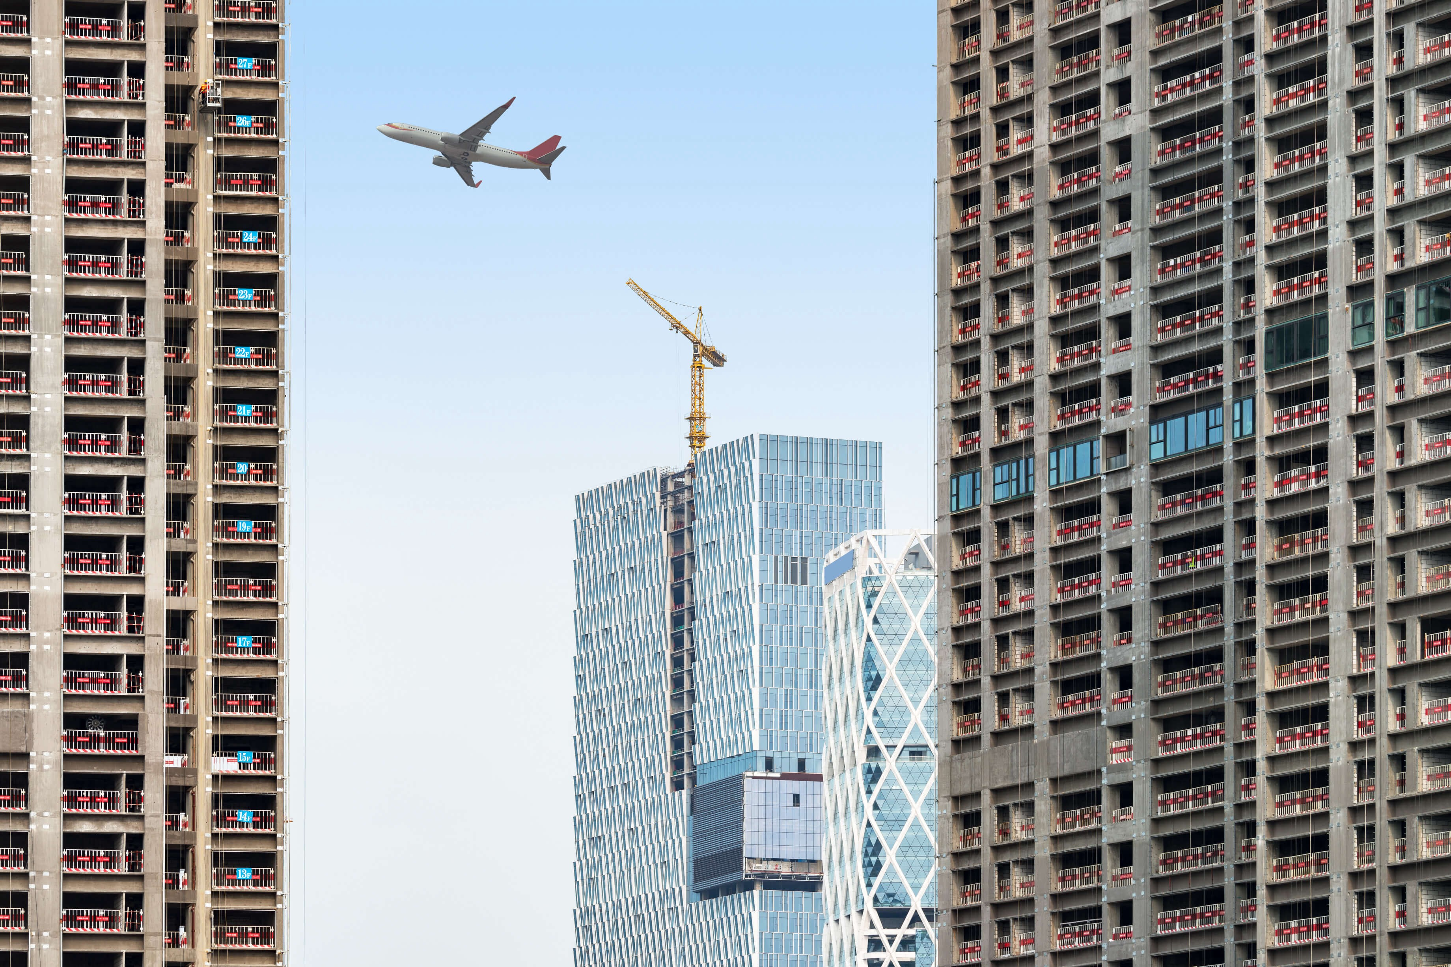
GİGDER | April 2020
Turkish Real Estate Sector After Covid-19
According to the analysis of GIGDER, 6.7 billion dollars of revenue was obtained from the overseas sale of real estate in 2019. In the last 5 years, revenue has increased by 59.5%.
Revenue from Overseas Real Estate Sales to Foreigners by Years (2015-2019)

Slide 7
GİGDER | April 2020
Turkish Real Estate Sector After Covid-19
First Quarter Indicators of 2020: Big growth until the second half of march
It is observed that real estate sector get off o good start in 2020 with optimistic climate in Turkey.
While the sales, which were 256 .433 in the first quarter of 2019, have been 341.038 in the first quarter of 2020, with an increase of approximately 33%.
With the announcement of the first case in March, the pace of real estate sales decreased, and it is observed that the sales, which started very good compared to the previous year, slowed in March.
Although the sales of March 2020 are above the previous year, the “brake effect” is expected to be reflected in the statistics of April..
Total Real Estate Sales - First Quarter Comparison of 2019-2020

Slide 8
GİGDER | April 2020
Turkish Real Estate Sector After Covid-19
Overseas Real Estate Sales: The impact of Covid-19 have been felt in the second half of March
Economic stagnation caused by the pandemic is not only a national problem, it is a global problem
The countries of existing and potential overseas investors of Turkish real estate sector have a quite negative outlook in terms of Covid-19
While pandemic have been at the top of agenda in Turkey in mid- March, it began to be monitored much earlier in the source countries (China, Iran, etc.)
On the other hand, liquidity has gained great importance for the investors and it is going through a process where investment actions slow down considerably.
In this direction;
It is observed that overseas real estate sales , which were realized as 9.618 unit in the first quarter of 2019, increased by 19.4% in the first quarter of 2020 and reached to 10.948 unit.
It is observed that this increase in 2020 was derived from the sales in the first two months.
However, after the announcement of first case, it was observed that overseas real estate sales have decreased in march due to gradual decrease in commercial activities, closing borders and #stayathome warnings
while the decrease rate is about 3% compared to the same month of the previous year; it is 24.2% compared to February.
First Quarter Comparison of Overseas Real Estate Sales - 2019-2020

Slide 9
GİGDER | April 2020
Turkish Real Estate Sector After Covid-19
In the second half of March, the Covid-19 pandemic and the negative reflections of the obligatory measures taken against the pandemic on commercial activities can also be monitored on Overseas real estate sales in big cities.
Partial decreases in overseas real estate sales are observed in all major cities except Muğla and Samsun.
2019-2020 March Comparisons of Overseas Real Estate Sales on a city basis

Slide 10
GİGDER |April 2020
Turkish Real Estate Sector After Covid-19
Stagnation, which started to be experienced in the second half of march 2020, can also be observed in real estate purchases by other country citizens.
A significant decrease is observed in sales to investors from Egypt, Jordan, Iraq, Iran and Turkmenistan.
Distribution of Overseas Real Estate Sales by Countries (2020- First Quarter)
Country | January | February | March | February-March Change (%) | Number of Covid-19 Cases (16 April)
Iran | 678 | 721 | 465 | -35,5 | 76,389
Iraq | 739 | 691 | 426 | -38,3 | 1,415
Russia | 254 | 282 | 227 | -19,5 | 27,938
Afghanistan | 204 | 256 | 184 | -28,1 | 840
Yemen | 142 | 131 | 113 | -13,7 | 1
Jordan | 107 | 141 | 86 | -39 | 401
Germany | 133 | 108 | 87 | -19,4 | 134,753
Palestine | 101 | 97 | 119 | +22,6 | 374
Saudi Arabia | 110 | 109 | 84 | -22,9 | 5,862
Azerbaijan | 99 | 90 | 95 | +5,5 | 1,253
Kuwait | 121 | 79 | 65 | -17,7 | 1,524
China | 78 | 87 | 86 | -1,1 | 82,341
Libya | 78 | 76 | 87 | +14,4 | 48
Egypt | 82 | 93 | 49 | -47,3 | 2,505
Kazakhistan | 65 | 74 | 72 | -2,7 | 1,341
Ukrain | 56 | 76 | 78 | +2,6 | 4,161
England | 72 | 66 | 65 | -1,5 | 98,476
Lebanon | 82 | 46 | 47 | +2,1 | 663
Turkmenistan | 59 | 57 | 38 | -33,3 | -
Sweden | 55 | 50 | 42 | -16 | 11,927
Other Countries | 630 | 718 | 560 | -22 | -

Slide 11
GİGDER | April 2020
Turkish Real Estate Sector After Covid-19
The Covid-19 outbreak is expected to be felt as of the second half of March 2020, but the actual “brake effect” is foreseen to be reflected in the April 2020 statistics.
The household withdrawal in the world and also in Turkey to home, international travel restrictions and the cancellation of the exhibitions, suspending of the investment actions poses a serious obstacle to access to potential investors in the source countries.
When the current fragile appearance is added to this situation, it seems difficult to maintain the performance that started well in 2020, but it is of great importance.
OVERSEAS Real Estate SALES - PROBLEMS AND ACTIONS
PROBLEMS
Closing the borders National and international airline transportation ceases Weakining of foreign customer demand Postponing real estate fairs Intermediary agency activities cease Disruption of sales, citizenship and other bureaucratic procedures due to public operational disruptions Delay in payments, financial disruption and liquidity problems in businesses Labor absence and productivity decline Decrease in business development processes Construction activities are included in the scope of force majeure, but excluding real estate sales activities Structural problems in benefiting from incentives and supports (ignorance, abstaining, length of procedures, non-constructive attitudes of some banks etc.)
ACTIONS TO BE TAKEN
Emphasis on e-commerce channels in real estate promotion and sales Digitization of bureaucratic processes - making them non-contact Constructing alternative financial instruments that facilitate real estate investment Including real estate sales activities as force majeure Acceleration of short-time working bureaucracy Acceleration of the bureaucracy of public banks Private banks being more constructive by taking more initiative in the process Digital staff, technological equipment, software and consulting etc. the financing of the factors included in the support Their support does not end with the slowing / ending of the outbreak and lasts another 12 months. Ensuring that the real estate sales activities for foreigners are included in the “foreign exchange earning service trade” and that they benefit from state aids. Speeding up the establishment of the overseas organization of the Ministry of Treasury & Finance While The fight against Covid-19 resolutely maintained, the image of "Turkey, island of health and stability" shoud be used the revival of European real estate demand

Slide 12
Salgın ve Gayrimenkul Sektörü
Ömer Faruk AKBAL
GİGDER Yönetim Kurulu Başkanı
One of leading sectors which is affected by the Covid-19 virus is the Real Estate sector, is one of the most important export fields and foreign currency generating services around the globe which is gaining importance every day. Turkey is located within the attraction centers of the world, before this pandemic, specifically for some geographies Turkey was the prime location for real estate investment. Within these uncertain days, it is even more important to establish the current reputation and strength without losing any momentum whatsoever in Covid-19 days.
When viewed in the scope of foreign exchange earning services, it is seen that the service sector is most affected by Covid-19, and our sector is directly and indirectly affected by this. Stopping of flights and travel restrictions have caused foreign customer traffic to come to a stopping point for those who wants to buy real estate from our country.
Within the light of these developments, it is apparent that PropTech application is much more important than before in the digital World. it will be easier to overcome the post covid-19 threshold in the digital market, therefore; the stakeholders especially the real estate sector in Turkey have to use the digital infrastructure and proptech applications quickly and effectivly.
In this period, our country has set the best example decisiding and implementing the proactive and constructive prevention packages to the world's public opinion and has signed indelible lines in humanitarian aid, including developed economies.
Those who invest in real estate in Turkey, is now far past beyond investing in the future.
It is a fact that, those who invest in Turkey, will also be investing in health opportunities
Those who invest in Turkey, will be investing in not only a peaceful future but also a healthy climate.
Those who invest in Turkey, will be investing in health and peace safe future as well as a strong administration.
With its increasing value in the world, the sector that we are in, has gained access to exemplary social infrastructure as well as economic gains, new opportunities to its new guests and to process the name of our country in bolder letters when it comes to real estate.
As the comfort and speed in the realization of the transactions are made possible by technology, we will continue to push the limits and we will encounter new records together.

